Slide 2
Counters
Counters are sequential circuits which "count" through a specific state sequence. They can count up, count down, or count through other fixed sequences. Two distinct types are in common usage:
Ripple Counters
Clock is connected to the flip-flop clock input on the LSB bit flip-flop
For all other bits, a flip-flop output is connected to the clock input, thus circuit is not truly synchronous
Output change is delayed more for each bit toward the MSB.
Resurgent because of low power consumption
Synchronous Counters
Clock is directly connected to the flip-flop clock inputs
Logic is used to implement the desired state sequencing

Slide 3
Ripple Counter
How does it work?
When there is a positive edge on the clock input of A, A complements
The clock input for flip- flop B is the complemented output of flip-flop A
When flip A changes from 1 to 0, there is a positive edge on the clock input of B causing B to complement
D
A
Clock
C_{R}
D
B
C_{R}
Reset
CP
A
B
0
1
2
3
0
1

Slide 4
Ripple Counter (continued)
These circuits are called ripple counters because each edge sensitive transition (positive in the example) causes a change in the next flip-flop’s state.
The changes “ripple” upward through the chain of flip-flops, i. e., each transition occurs after a clock-to-output delay from the stage before.

Slide 5
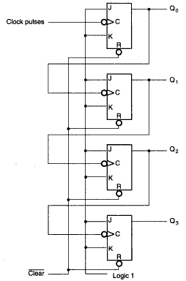
Ripple Counter: 4-bit Upward Counter
Remember J-K toggles when both J and K are ‘1’
The bubble on the clock means negative-edge triggered
When Q0 goes from ‘1’ to ‘0’ (as if a negative-edge has been triggered to clock of Q1), Q1 toggles
When Q1 goes from ‘1’ to ‘0’, Q2 toggles
When Q2 goes from ‘1’ to ‘0’, Q3 toggles

Slide 6
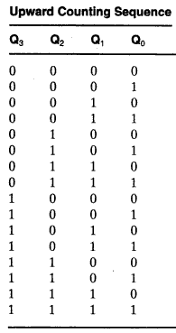
Ripple Counter: 4-bit Upward Counter
When Q0 goes from ‘1’ to ‘0’ (as if a negative-edge has been triggered to clock of Q1), Q1 toggles
When Q1 goes from ‘1’ to ‘0’, Q2 toggles
When Q2 goes from ‘1’ to ‘0’, Q3 toggles
What about the last sequence: how it goes from ‘1111’ to ‘0000’?

Slide 7
Synchronous Counters
To eliminate the "ripple" effects, use a common clock for each flip-flop and a combinational circuit to generate the next state.
For an up-counter, use an incrementer =>
Incre-menter
A3
S3
D3
Q3
A2
S2
D2
Q2
A1
S1
D1
Q1
A0
S0
D0
Q0
Clock

Slide 8
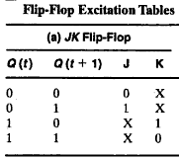
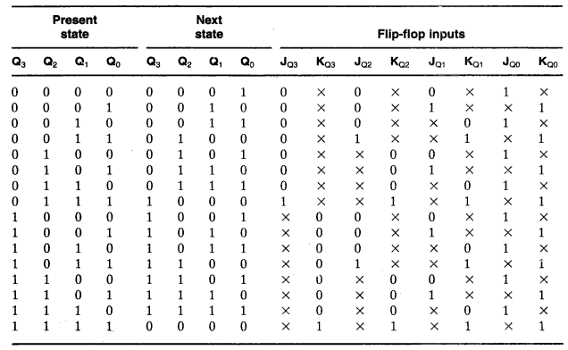
4-bit Synchronous Counter with J-K

Slide 9
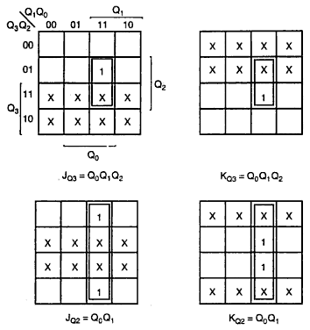
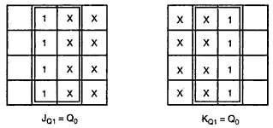
K-Maps

Slide 10
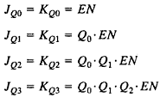
Equations
EN has been added to control the operation of the counter
This relations could be generalized
A Carry Output (CO) has been added so that the counter could be extended to more stages
The implementation might be positive/negative edge triggered

Slide 11
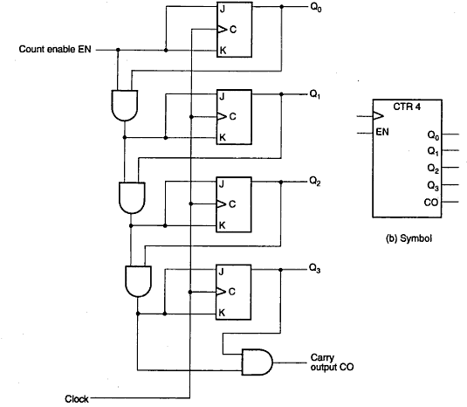
Logic Diagram

Slide 12
Arbitrary Counter: Problem Statement
Design an arbitrary counter that repeatedly follows the following sequence:
0, 1, 2, 4, 5, 6, 0, 1, 2, 4, 5, 6, 0. . .

Slide 13
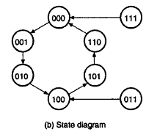
Arbitrary Counter: State Diagram

Slide 14
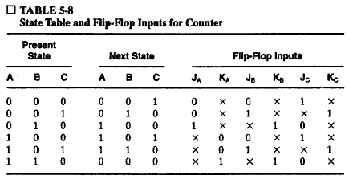

Arbitrary Counter: State Table

Slide 15
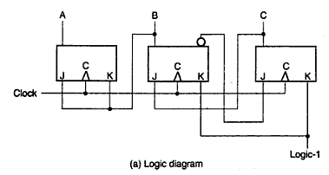
Arbitrary Counter: Logic Diagram

